Slide 1
Packator dashboard
by Camilo Cuevas

Slide 2

A small Start-up from Berlin
Package delivery platform for pick-ups in whole Germany and deliveries worldwide.
7 employees.
200 orders a day.
3 years of data stored in csv files.
Notes:
Web app for booking shipping of almost any package
I used to work with them

Slide 3
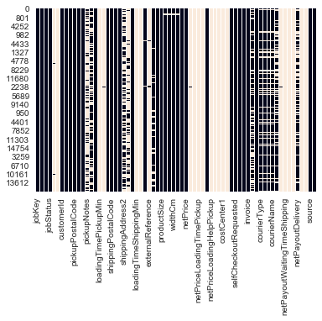
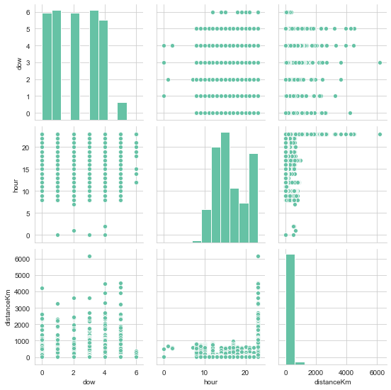
Getting started
Notes:
Jupyter notebook without knowing what to do.
Data Viz focused
Messy data
Correlation, outliers
this eda helped me understand that i wanted metabase

Slide 4



Data pipeline
digest.py
Metabase
AWS EC2
postgreSQL
AWS RDS
Notes:
Basically same structure as on the weekly project

Slide 5
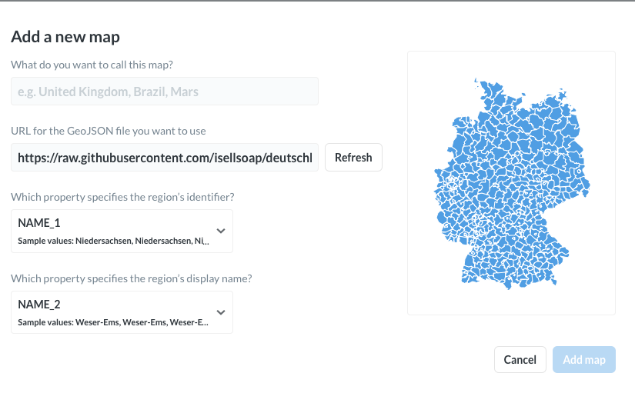


Most challenging part...
Unable to parse resource at: `https://github.com/annexare/Countries/blob/master/package.json` as JSON
Notes:
Metabase not recognizing the geojson file
jsonbin.io worked but only for a more detailed version of map
github repo saved me + realized u need to parse in the raw geojson

Slide 6
Metabase
Dashboard

Slide 7
What is next:
Automatic Dashboard updates.
Use private server hosted on raspberry pi.
Github repository.

